Slide 1
Module 4-Mechanics
Collisions

Slide 2

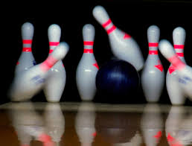


Conservation of momentum
and
conservation of energy
Collisions occur when one object strikes another
Inelastic collisions: momentum is conserved
Elastic collisions: momentum is conserved
and
kinetic energy is conserved.
Collisions
Elastic collisions
and
Inelastic collisions

Slide 3
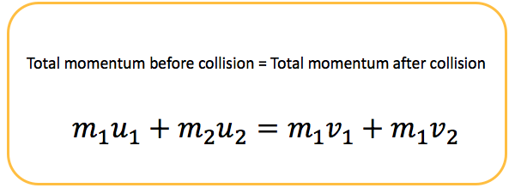
Conservation of Momentum
For a collision occurring between object 1 and object 2 in an isolated system, the total momentum of the two objects before the collision is equal to the total momentum of the two objects after the collision. That is, the momentum lost by object 1 is equal to the momentum gained by object 2.

Slide 4
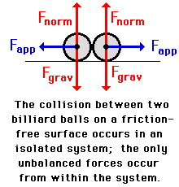
Isolated System
A system is a collection of two or more objects. An isolated system is a system that is free from the influence of a net external force that alters the momentum of the system. There are two criteria for the presence of a net external force;
a force that originates from a source other than the two objects of the system
a force that is not balanced by other forces.
A system in which the only forces that contribute to the momentum change of an individual object are the forces acting between the objects themselves can be considered an isolated system.

Slide 5
Why at all is momentum conserved ?
Consider a collision between two objects, object A and object B. When the two objects collide, there is a force on A due to B F_{AB}
and because of Newton's third law, there is an equal force in the opposite direction, on B due to A F_{BA}
F_{AB} = -F_{BA}
The forces act between the objects when they are in contact. The length of time for which the objects are in contact are t_{AB} and t_{BA} respectively
t_{AB} = t_{BA}

Slide 6
Consequently, the impulse experienced by objects A and B must be equal in magnitude and opposite in direction.
F_{AB} .t_{AB} = -F_{BA}.t_{BA}
Impulse is equivalent to change in momentum, and hence change in momenta of the objects is equal but in the opposite directions. This can be equivalently expressed as the sum of the change in momenta being zero.
m_{A}.∆V_{A} = -m_{B}.∆V_{B}
m_{A}.∆V_{A} + m_{B}.∆V_{B}
= 0

Slide 7
Interesting features about conservation of momentum
Collisions are particularly interesting to analyze using conservation of momentum. This is because collisions typically happen fast, so the time colliding objects spend interacting with each other is short. So, impulse due to external forces, for eg., frictional will also be very small.
It is often easy to measure and keep track of momentum, even with complicated systems of many objects
Collisions with "immovable" objects are interesting. Of course, no object is really immovable, but some are so heavy that they appear to be. Consider the case of a bouncy ball of mass m traveling at velocity v towards a brick wall. It hits the wall and bounces back with velocity -v. The wall is well attached to the earth and doesn't move, yet the momentum of the ball has changed by 2mv since velocity went from positive to negative. If momentum is conserved, then the momentum of the earth and wall also must have changed by 2mv. We just don't notice this because the earth is so much heavier than the bouncy ball.

Slide 8
A 15-kg ball is thrown at a velocity of 20 km/hr to a 60-kg person who is at rest on ice. The person catches the ball and subsequently slides with the ball across the ice. Determine the velocity of the person and the ball after the collision.
m1v 1+ m2v2 = m1vf +m2vf
15x20 +0 = (15+60)vf
Vf = 1.11m/s

Slide 9
A 0.150-kg baseball moving at a speed of 45.0 m/s crosses the plate and strikes the 0.250-kg catcher's mitt (originally at rest). The catcher's mitt immediately recoils backwards (at the same speed as the ball) before the catcher applies an external force to stop its momentum. If the catcher's hand is in a relaxed state at the time of the collision, determine the post-collision velocity of the mitt and ball.
m1v 1+ m2v2 = m1vf +m2vf
0.15x45 +0 = (0.15+0.25)vf
Vf = 16.875m/s

Slide 10
A 3000-kg truck moving with a velocity of 10 m/s hits a 1000-kg parked car. The impact causes the 1000-kg car to be set in motion at 15 m/s. Assuming that momentum is conserved during the collision, determine the velocity of the truck immediately after the collision.
m1v 1i+ m2v2i = m1v1f +m2v2f
V1f = 5 m/s

Slide 11
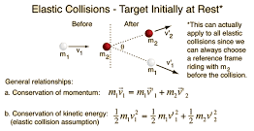
Elastic collisions
An elastic collision is a collision in which there is no net loss in kinetic energy in the system as a result of the collision. Both momentum and kinetic energy are conserved quantities in elastic collisions.

Slide 12
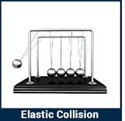
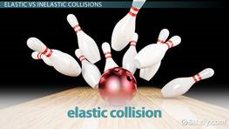

Slide 13
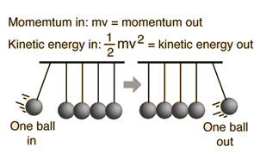
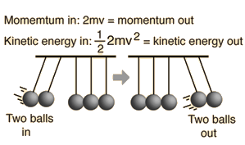
A popular demonstration of conservation of momentum and conservation of energy features several polished steel balls hung in a straight line in contact with each other. If one is pulled back and allowed to strike the line, one ball flies out the other end. If two balls are sent in, two come out, and so forth.

Slide 14
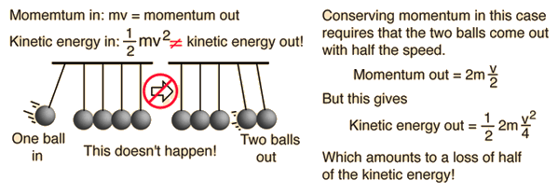
Now consider the possibility of one ball coming in and two balls coming out. It could conserve momentum if the two balls coming out had half the speed of the single ball that came in. But how about energy?
Two balls out could conserve momentum, but only by violating conservation of energy, so it does not happen.

Slide 15
For macroscopic objects which come into contact in a collision, there is always some dissipation and they are never perfectly elastic. Collisions between hard steel balls as in the swinging balls apparatus are nearly elastic.
Collisions in which the objects do not touch each other, such as Rutherford scattering or the slingshot orbit of a satellite off a planet, are elastic collisions. In atomic or nuclear scattering, the collisions are typically elastic because the repulsive Coulomb force keeps the particles out of contact with each other.
Collisions in ideal gases are very nearly elastic, and this fact is used in the development of the expressions for gas pressure in a container.
* Manoeuvres of planetary exploration vessels are really elastic collisions where the objects involved never hit each other but are affected by gravity as they approach are called slingshot orbit

Slide 16
Suppose a head-on elastic collision occurs between two objects 1 and 2 on a track. We want to know the final velocities for both the objeccts, but are only given the initial velocities V_{Ai}, and V_{Bi}.
Applying conservation of momentum we can see that we have one equation with two unknowns.
m₁v_{1i} + m₂v_{2i} = m₁v_{1f} + m₂v_{2f}
Because kinetic energy is also conserved, we simultaneously have another constraint:
½ m₁v_{1i}² + ½ m₂v_{2i}² = ½ m₁v_{1f}² + 1/2m₂v_{2f}²

Slide 17
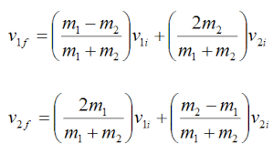
Solving these equations we get

Slide 18
Analysis of different cases
Case 1: Object 1 collides with an equal mass target 2
which is at rest:
V1f = 0
V2f =V1i
The impacting object comes to a dead stop, the target gains the exact same speed as the impacting object. (Newton’s cradle )

Slide 19
Case 2: Object 1 collides with an equal mass object 2.
Objects have equal but oppositely directed
velocity.
V1f = v2i
V2f =v1i
The two objects bounce off each other, exchanging velocity. Interestingly, this result also holds for two objects colliding with equal but opposite momentum: the objects will swap momentum.

Slide 20
Case 3: A heavy object collides with a much lighter target which
is at rest.(m₁>>m₂)
V1f =v1i
V2f =2v1i
The final velocity of the heavy object tends to its initial velocity, i.e., the light object has little effect on the heavy one.

Slide 21
Case 4: A light object collides with a much heavier target which is
at rest. m₂ >>m₁
V1f =-v1i
V2f =0
The light object bounces off the target, maintaining the same speed but with opposite direction. The heavy target remains at rest.

Slide 22
A badminton player serves a shuttle. The speed of her racket is measured by high speed camera at v_{r} = 20m/s just prior to striking the shuttle. Approximately what speed would you expect the shuttle to be travelling after the collision? If the racket has a mass of m=100gm and the shuttle a mass of m=5 gm calculate the exact speed v_{s} assuming an elastic collision.
VSf =38 m/s

Slide 23
INELASTIC COLLISION
Perfectly elastic collisions are those in which no kinetic energy is lost in the collision.
Macroscopic collisions are generally inelastic and do not conserve kinetic energy, though of course the total energy is conserved as required by the general principle of conservation of energy.
The extreme inelastic collision is one in which the colliding objects stick together after the collision, and this case may be analyzed in general terms:

Slide 24
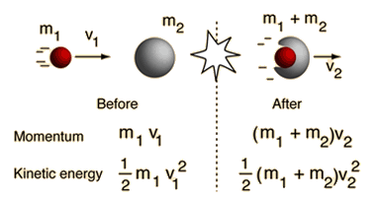

Slide 25
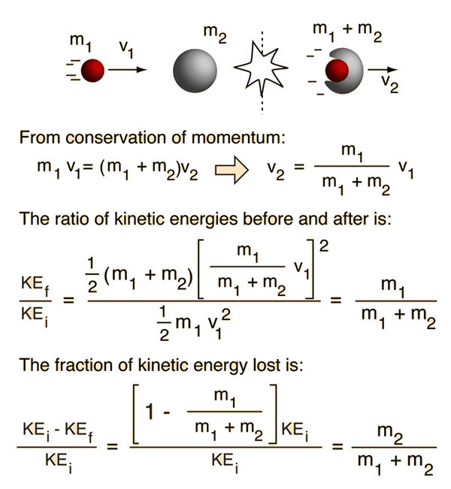
One of the practical results of this expression is that a large object striking a very small object at rest will lose very little of its kinetic energy. If a car strikes a cat, , it is unfortunate for the cat but will not appreciably slow your car.
On the other hand, if a small object collides inelastically with a large one, it will lose most of its kinetic energy.

Slide 26
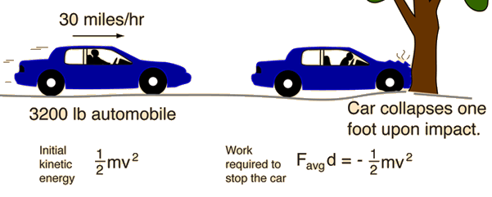
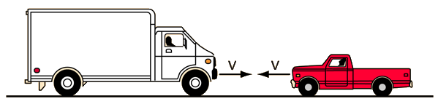
A car crash
A truck collision

Slide 27
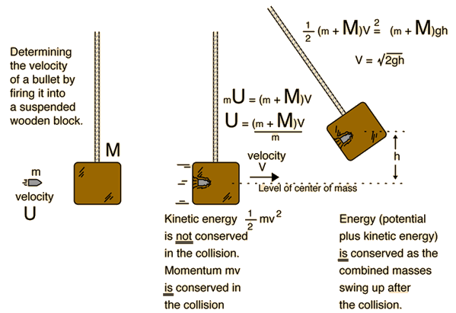
In the special case where two objects stick together when they collide, the fraction of the kinetic energy which is lost in the collision is determined by the combination of conservation of energy and conservation of momentum.

Slide 28
Applying conservation of momentum to the collision process
mu =(m+M)v
u = (m+M)v/m Or v = mu/m+M (1)
We know that after the collision, the mechanical energy of the block-bullet system is conserved, so if the block rises up to a maximum height ’h’ under a gravitational acceleration ’g’ then:
½ (m+M)v² = (m+M)gh
v² = 2gh
v =(2gh)^{1/2} 2
Equating (1) and (2)
mu/(m+M) = (2gh)^{1/2}
u = ((m+M)/m )x(2gh)^{1/2}

Slide 29
Suppose a 10 gram musket ball is fired into a 1 kg block which is part of a ballistic pendulum apparatus, It swings to a height of 0.3 m. What is the initial speed of the ball?
u = ((m+M)/m )x(2gh)^{1/2}
U = 245 m/s
Suppose the musket ball in the previous exercise was replaced with a bullet of half the mass and twice the initial speed. Would it be safe to do the experiment with the same apparatus? Would you expect the same result?
h = 0.3 m

Slide 30
References:
http://hyperphysics.phy-astr.gsu.edu/hbase/balpen.html#c1
https://www.khanacademy.org/science/physics/linear-momentum/
elastic-and-inelastic-collisions/a/what-are-elastic-and-inelastic-collisions

Slide 31
Three objects A, B and C are kept in a straight line on a frictionless horizontal surface. These have masses m, 2m and m, respectively. The object A moves towards B with a speed 9 m/s and makes an elastic collision with it. Thereafter, B makes completely inelastic collision with C. All motions occur on the same straight line. Find the final speed (in m/s) of the object C.
Ans:
Apply
Conservation of momentum
and energy
Vb = 6 m/s
2. Apply conservation of momentum
Vc = 4 m/s

Slide 32

The coefficient of restitution is defined as the ratio of the magnitudes of the initial and final relative velocities i.e.,
e=velocity of separation / velocity of approach
e = −(v′1−v′2)/ (v1−v2)
The linear momentum of the system is conserved in a collisions.
In an elastic collision, coefficient of restitution is 1 and change in kinetic energy is zero.

